Slide 1

Reporting and Analyzing Cash and Internal Controls
6
Chapter
UAA – ACCT 201 Principles of Financial Accounting Dr. Fred Barbee

Slide 2
Day #2
IS FUN!
ACCOUNTING
ACCT 201 ACCT 201 ACCT 201

Slide 3
Chapter 6 - Day 2 - Agenda
Topic | LO | Read | HW
Banking Activities as Controls | C4, P5 | 262-269 | E6, E7, E8
Decision Analysis | A1 | 269-270 | QS7, E9
No Homework Due Today!

Slide 4
Reporting and Analyzing Cash and Internal Controls
6
Chapter
Banking Activities as Controls

Slide 5
Bank Reconciliations
ACCT 201 ACCT 201 ACCT 201

Slide 6
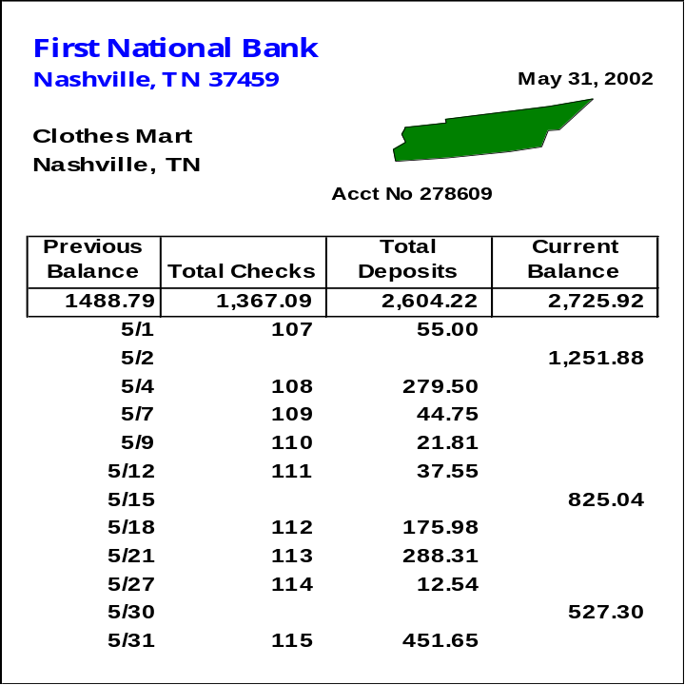
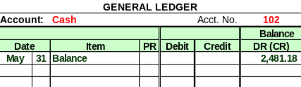
Bank Reconciliation
A bank reconciliation is prepared to explain the difference between cash reported on the bank statement and the cash balance on company’s books.
*
Why are the
balances different?

Slide 7

Reconciling Bank Statement Balance
Deduct: Outstanding checks.
Add: Deposits in transit.
Add or Deduct: Bank errors.

Slide 8
Reconciling Book Balance
Deduct: NSF checks (NSF).
Deduct: Bank service charge.
Add: Interest earned
Add: Collections made by the bank.
Add or Deduct Book errors.

Slide 9

Bank Reconciliation
Two sections:
  Reconcile bank statement balance to the adjusted bank balance.
  Reconcile book balance to the adjusted book balance.
The adjusted balances should be equal.

Slide 10
Bank Reconciliation Example
Let’s prepare a July 31 bank reconciliation for the Simmons Company.
  The July 31 bank statement indicated a balance of $9,610,
  while the cash general ledger account on that date shows a balance of $7,430.

Slide 11

Bank Reconciliation Example
  Outstanding checks totaled $2,417.
  A $500 check mailed to the bank for deposit had not reached the bank at the statement date.
  The bank returned a customer’s NSF check for $225 received as payment on account receivable.
  The bank statement showed $30 interest earned during July.
  Check No. 781 for supplies expense cleared the bank for $268 but was erroneously recorded in our books as $240.
  A $486 deposit by Acme Company was erroneously credited to our account by the bank.

Slide 12
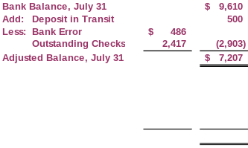
Simmons Company
Bank Reconciliation
July 31, 2002
ACCT 201 ACCT 201 ACCT 201

Slide 13
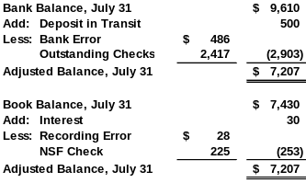
Simmons Company
Bank Reconciliation
July 31, 2002
ACCT 201 ACCT 201 ACCT 201

Slide 14
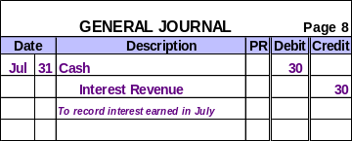
Recording Adjusting Entries from Bank Reconciliation
Only amounts shown on the book portion of the reconciliation require an adjusting entry.
 

Slide 15
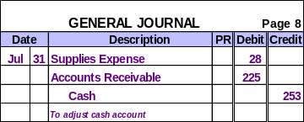
Recording Adjusting Entries from Bank Reconciliation
Only amounts shown on the book portion of the reconciliation require an adjusting entry.
 
 

Slide 16
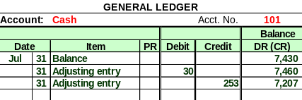
Recording Adjusting Entries from Bank Reconciliation
After posting the reconciling entries the cash account looks like this:
Adjusted balance on July 31.

Slide 17
Days’ Sales Uncollected
How much time is likely to pass before
we receive cash receipts from credit sales.
Days’
Sales
Uncollected
Accounts Receivable
Net Sales
=
× 365

